Slide 1

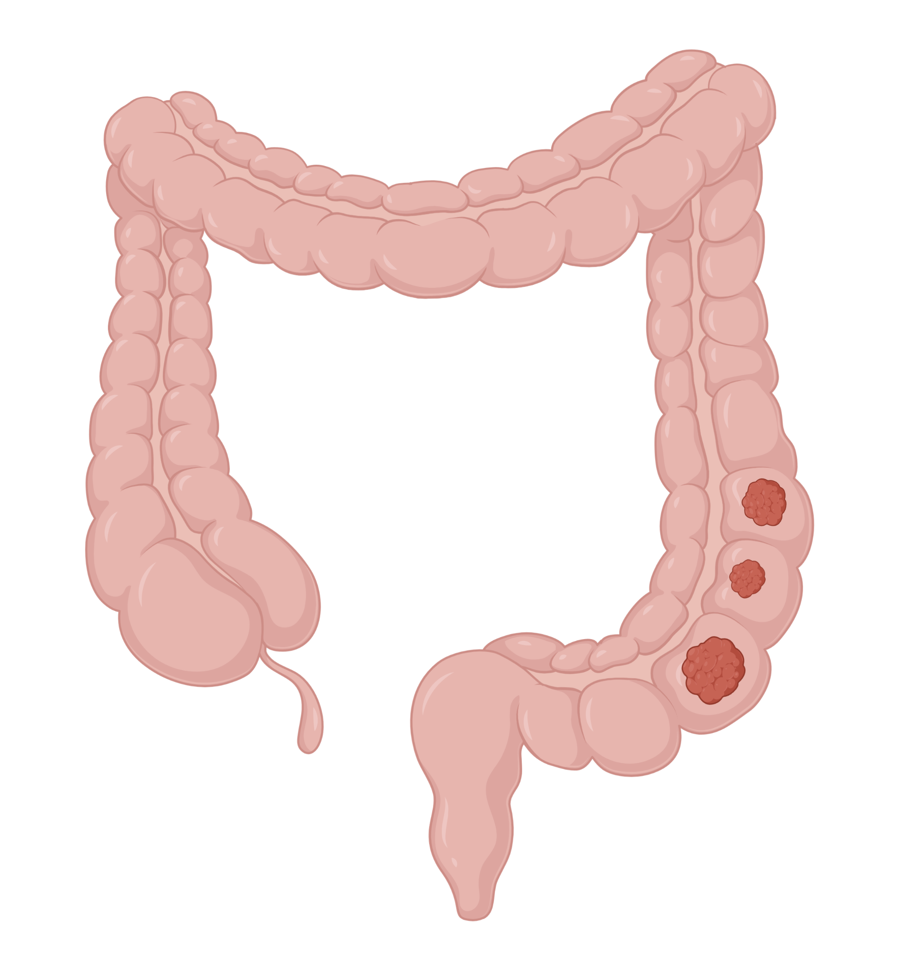

When to screen?
5 domains of prevention/screening
Adult Disease Prevention
Part 1 – Cancer Screening and Immunizations
Cancer Screening
Infectious Disease
CASES
Graphics by biorender.com

Slide 2

When to screen?
When to screen?
Conditions for Effective Screening
5 domains of prevention/screening
Cancer Screening
DISEASE CHARACTERISTICS?
SCREENING TEST
CHARACTERISTICS?
Infectious Disease
Common
Asymptomatic period
Early > Late treatment
Acceptable sensitivity/specificity
Low-cost
Easy to complete
Minimal patient harm
BOTTOM LINE:
BENEFITS > RISKS/HARMS
CASES

Slide 3
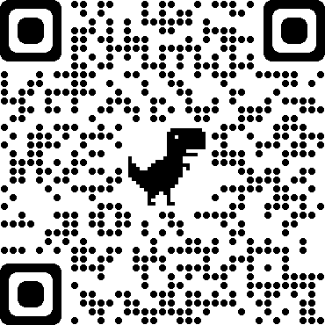
When to screen?
Adult Disease Prevention – Average Risk Patient
5 domains of prevention/screening
Cancer
Infectious Disease
Psychosocial
(See Prev 2)
Cardiovascular disease
(See Prev 2)
Family/Safety
(See Prev 2)
Prioritize Screening and Prevention Based On:
Age
Sex
Risk Factors
Cancer Screening
Infectious Disease
Can’t keep it straight?
ADULT DISEASE SCREENING & PREVENTION
Use the USPSTF Tool
CASES

Slide 4
When to screen?
Breast Cancer Screening
5 domains of prevention/screening
Population?
Modality and Interval?
Discontinuation?
Cancer Screening
All average-risk females ages 40-74 (Grade B)
Mammogram every 2y​
If life expectancy is <10y
OR
>74
Breast
Colon
Cervical
Lung
Prostate
Mammogram q2y
Infectious Disease
20
30
40
50
60
70
80
CASES

Slide 5
When to screen?
Colon Cancer Screening
5 domains of prevention/screening
Population?
Modality and Interval?
Discontinuation?
Cancer Screening
Average-risk patients ages 45-79
(age 45-49 is Grade B)
(age 76-84 is Grade C)
Colonoscopy | q10y
gFOBT/FIT | q1y
sFIT+DNA | q3y
CT colonography or sigmoidoscopy | q5y
Selectively offer in patients age 75 to 85 based on patient factors.
Breast
Colon
Cervical
Lung
Colonoscopy – q10y
gFOBT/ FIT – q1y
sFIT+DNA – q3y
CT colonography sigmoidoscopy – q5y
Prostate
Infectious Disease
20
30
40
50
60
70
80
CASES

Slide 6
When to screen?
Cervical Cancer Screening
5 domains of prevention/screening
Population?
Modality and Interval?
Discontinuation?
Cancer Screening
USPSTF Guidelines
Starting age 21 (Grade A)
ACS Guidelines
Starting age 25
21-29y | Cytology q3y
30-65y | Cytology q3y HPV ± cytology q5y
>65y with normal screening in prior 10y
OR
Hysterectomy with removal of cervix + no prior history of high-grade precancerous lesion
Breast
Colon
Primary HPV | q5y
HPV + cytology | q5y
Cytology | q3y
Cervical
Lung
Prostate
ACS
USPSTF
Infectious Disease
20
30
40
50
60
70
80
CASES
Notes:
Update in progress

Slide 7
When to screen?
Lung Cancer
5 domains of prevention/screening
Population?
Modality and Interval?
Discontinuation?
Cancer Screening
Ages 50-80 with at least
20 pack-year history + smoked within the past 15y (Grade B)
Annual low-dose CT scan
If quit smoking >15y ago
OR
Limited life expectancy
Breast
Colon
Cervical
Medicare requires a shared decision-making visit prior to first screening.
Lung
Prostate
Annual low dose CT scan
Infectious Disease
20
30
40
50
60
70
80
CASES
Notes:
Medicare documentation needs to include:
Documentation of eligibility for screening
Use of a decision aid
Counseling on adherence to annual LDCT, impact of comorbidities, and ability or willingness to undergo diagnosis and treatment
Counseling on smoking cessation

Slide 8
When to screen?
Prostate Cancer Screening
5 domains of prevention/screening
Population?
Modality and Interval?
Discontinuation?
Cancer Screening
Males aged 55-69y (Grade C)
No screening or PSA every 1-2y​
If >70y
Breast
Colon
Cervical
Lung
Prostate
± PSA q1-2y
Infectious Disease
20
30
40
50
60
70
80
CASES
Notes:
Update in progress

Slide 9
When to screen?
Infectious Disease Prevention – Immunizations
5 domains of prevention/screening
Everyone
Specific Indications
Influenza
Annually
Cancer Screening
COVID
At least every fall
Infectious Disease
Tdap or Td
Tdap once → Td or Tdap q10y
Immunizations
Hep B
19-59y if not immune
>60 only if high risk
Infections
HPV
19-26y (preferred) or up to 45y
PCV21 for 19-49y w/chronic dz
PCV21 for >50y
Pneumonia
PCV21 for immunocompromised, asplenia, CSF leak, cochlear implant
Shingles
>50y, 2 doses (2-6 mos apart)
CASES
20
30
40
50
60
70
80
Notes:
Could do pcv15 (would need additional vacc with ppsv23)…could use pcv20
Based on shared clinical decision-making, adults 65 years or older have the option to get PCV20 or PCV21, or to not get additional pneumococcal vaccines. They can get PCV20 or PCV21 if they have received both

Slide 10
When to screen?
Infectious Disease Prevention – Infection Screening
5 domains of prevention/screening
Everyone
At Risk
Cancer Screening
HIV
Once for ages 15-65
MSM, IVDU, sex workers, and more*
Infectious Disease
Hepatitis C
Once for ages 18-79
IVDU, MSM + HIV, HD, sex partner with HCV
Immunizations
Infections
Gonorrhea/ Chlamydia
F < 24 + sex
F with multiple partners, partners with STI, inconsistent barrier protection
Syphilis
MSM, HIV, incarcerated, sex work
Hepatitis B
Born in high HBV areas (Asia, Africa, etc), MSM, HIV, IVDU
Latent TB
Lived in high TB countries, congregate settings
CASES
20
30
40
50
60
70
80
Notes:
GC/CT screening
sexually active women < 24 (B)
At risk = new or multiple sex partners, a sex partner with concurrent partners, or a sex partner with a sexually transmitted infection (STI); inconsistent condom use among persons who are not in mutually monogamous relationships; previous or concurrent STI; and exchanging sex for money or drugs.
HIV (A)
All 15-64
At risk: Most new diagnoses of HIV infection are attributed to male-to-male sexual contact; injection drug use is another important risk factor. Additional risk factors include having anal intercourse without a condom, having vaginal intercourse without a condom and with more than 1 partner whose HIV status is unknown, exchanging sex for drugs or money (transactional sex), having other STIs or a sex partner with an STI, and having a sex partner who is living with HIV or is in a high-risk category. Persons who request testing for STIs, including HIV, are also considered to be at increased risk.
Hep C
Syphillis screening (A)
Men who have sex with men and persons living with HIV have the highest risk for syphilis infection. Other factors that are also associated with increased prevalence rates include a history of incarceration or commercial sex work, geography, race/ethnicity, and being a male younger than 29 years. Screening in asymptomatic patients is recommended for all pregnant patients, MSM, HIV, history of incarceration or commercial sex work, high risk sexual behaviors (e.g., diagnosed with STI, exchange sex for money or drugs, multiple unprotected sexual partners).
Hepatitis B (B)
- Persons born in countries and regions with a high prevalence of HBV infection (≥2%), such as Asia, Africa, the Pacific Islands, and parts of South America
- US-born persons not vaccinated as infants whose parents were born in regions with a very high prevalence of HBV infection (≥8%)
- HIV-positive persons
- Persons with injection drug use
- Men who have sex with men
- Household contacts or sexual partners of persons with HBV infection
Latent TB (B)
- born in, or are former residents of, countries with increased tuberculosis prevalence and persons who live in, or have lived in, high-risk congregate settings (eg, homeless shelters and correctional facilities). Local demographic patterns may vary across the United States; clinicians can consult their local or state health departments for more information about populations at risk in their community.

Slide 11
When to screen?
Case 1
Case 2
Case 3
5 domains of screening
54 yo W presents to establish care. She has a history of hypertension controlled on amlodipine 10 mg. She has smoked 1 ppd since she was 19 - tried quitting in the past but is not interested right now. Had a normal colonoscopy 4 years ago and a mammogram 2 years ago. She can’t recall her last pap smear but has never had abnormal results. No family history of cancer. Sexually active with her husband.
VS: Ht 5’4”, Wt 145lbs, HR 76, BP 132/75, RR 18, SpO2 94%
PE: Unremarkable cardiac and pulmonary exams.
56 yo homeless M presents to establish care. He has not seen a provider for 8 years. He takes no medications and has no allergies. He has smoked ½ ppd for the past 20 years. Denies any illicit drug use and quit drinking alcohol 2 years ago. No family history of cancer and not currently sexually active.
VS: Ht 5’10”, Wt 165lbs, HR 82, BP 138/80, RR 16, SpO2 95%
PE: Unremarkable cardiac and pulmonary exams.
32 yo G2P2 W presents for a physical. She has hypothyroidism on levothyroxine. She is sexually active with her boyfriend and has an IUD in place. Her last pap smear was 3 years ago when she was pregnant with her second child and it was normal. HPV testing was not done at that time. She does not know her family history of cancer.
Cancer Screening
Infectious Disease
Immunizations
What cancer screening is recommended?
Cervical cancer screening
Infections
Primary hrHPV or hrHPV + cytology co-test
What would you order?
1) Colon Cancer, 2) +/- Prostate Cancer
What cancer screening is recommended?
Repeat testing in 1 year
Her cytology shows a low-grade squamous intraepithelial lesion (LSIL) with negative HPV. What is your next step?
1) Breast cancer, 2) Lung cancer, 3) Cervical cancer
What cancer screening is recommended?
What would you order and how would you counsel him?
FIT, gFOBT or FIT+DNA for colon cancer screening
Discuss prostate cancer screening, likely recommend against it at this time
Bilateral screening mammogram
LDCT scan after shared decision making discussion
Primary hrHPV test or Cytology + hrHPV co-test
What would you order and how you would counsel her?
CASES

Slide 12
2025 Update — USPSTF Cervical Cancer Screening
The deck's cancer-screening framework, breast (40–74 q2y, 2024), colon (45–79), lung (50–80/20py/15y), prostate (55–69 Grade C), PCV21, Hep B 19–59 and infection screening were all verified CURRENT (deck is the June-2025 build).
NEW — USPSTF finalized cervical cancer screening (2025), Grade A:
• Ages 21–29: cytology alone every 3 years (unchanged).
• Ages 30–65: high-risk HPV PRIMARY screening every 5 years is now the PREFERRED strategy.
• FIRST-TIME endorsement of SELF-COLLECTED (patient-collected) HPV samples — clinician- OR patient-collected accepted; aims to expand access.
• Alternatives at 30–65: cytology alone q3y, or HPV+cytology co-test q5y.
Caveat: ACS still starts at 25; ASCP/CETC raised concerns about equivalence and the 5-yr interval for self-collected samples. Confirm your institution's protocol.

Slide 13
Take-Home Points
Screening pays off only when the disease is common, has a detectable asymptomatic phase, early treatment beats late, and the test is accurate, cheap, and low-harm — benefits must outweigh harms/cost.
Five domains of adult prevention: Cancer, Infectious Disease, Cardiovascular, Psychosocial, Family/Safety. Individualize by age, sex, risk factors, comorbidities, and life expectancy.
Only 5 cancers have screening: breast (40–74 q2y), colon (45–79), cervical (21–65), lung (50–80, 20 pack-yr, quit <15y), prostate (55–69, shared decision, Grade C).
Immunizations 2024–25: PCV21 for adults ≥50 (and 19–49 with chronic disease); RSV vaccine for ≥75 (and 60–74 at higher risk) via shared decision-making; Hep B universal 19–59.
2025: USPSTF endorses self-collected HPV; primary HPV q5y preferred at 30–65. Use the USPSTF tool to keep guidelines straight.

Slide 14
Attribution & Optimization Notes
Adapted from TeachIM.org — “Adult Disease Prevention Part 1: Cancer Screening and Infectious Diseases” (Melton; Exec. Ed. Zhang; Sec. Ed. Brett; Univ. of Colorado / Univ. of Washington). Published Sept 2021, last reviewed June 2025.
Source URL: https://teachim.org/teaching_material/adult-disease-prevention-1/ | Deck: prevention-1-updated-2025.pptx (embed-verified)
Licensed under Creative Commons Attribution-NonCommercial 4.0 (CC BY-NC 4.0). This optimized package is likewise CC BY-NC 4.0 — attribution required, non-commercial use only.
Optimized June 2026: original interactive board preserved (all 11 slides, animations & BioRender graphics intact). 1 surgical fix: slide 6 button label "USPTF" → "USPSTF" (single text run; animations preserved). 3 slides appended (this addendum).
Currency verified vs USPSTF (2024 breast; 2025 cervical self-collection final), ACIP 2024 (PCV21), and CDC RSV guidance. Companions: teaching script DOCX, cancer-screening learner handout PPTX, PCE summary PPTX.
Educational use only — clinician-reviewed before teaching; guidelines change frequently (check USPSTF/ACIP and local protocol).

